Slide 1
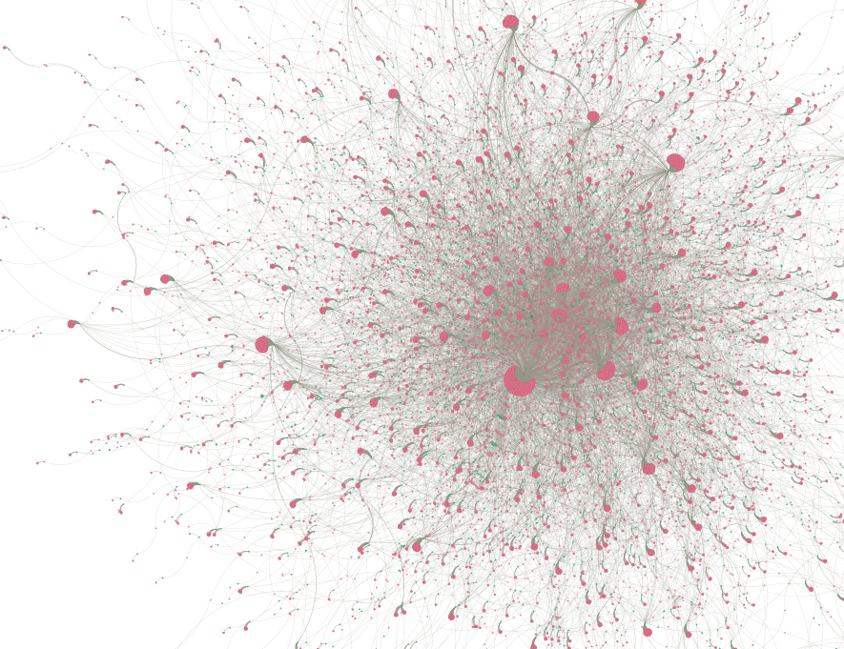
Hypergraph Anomaly Detection
Deven Biehler
Sai Kolagani
Notes:
Welcome to our project.
This is a collaborative project between the two of us to apply existing hypergraph learning models, which we suspected were currently underrepresented in the current landscape for anomoly detection methods.

Slide 2
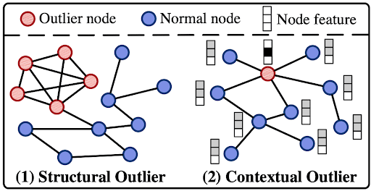
Anomaly Detection
Two types of outlier data when it comes to graph data.
Notes:
Anomoly detection is an old problem with great incentive for research as it is a crucial tool for protecting users from spam, scams, and hackers.
There are two kinds of outlier detection when it comes to network anomalies, first is the structural outlier, this is when a node or cluster of nodes appears to have a different structure than the overall network.
The second is the classic contextual outlier which comes from the context of the observation. In other words, it is an outlier based on the content of one node when compared to the usual content of a node in the network.

Slide 3
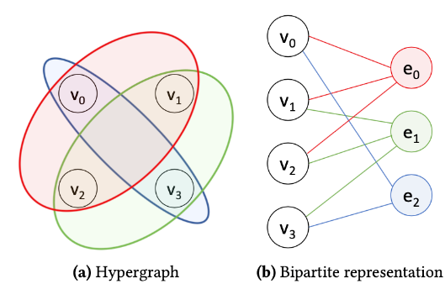
Hypergraphs
Bipartite graphs can be converted to hypergraphs.

Slide 4
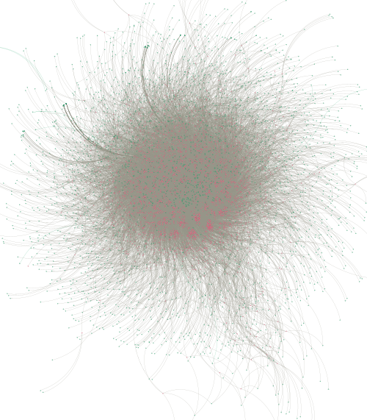
Anomalous User Detection
On Reddit Dataset
Notes:
The first dataset we approached was a basic user to web forum database that had a user ID, forum ID, message and timestamp.

Slide 5
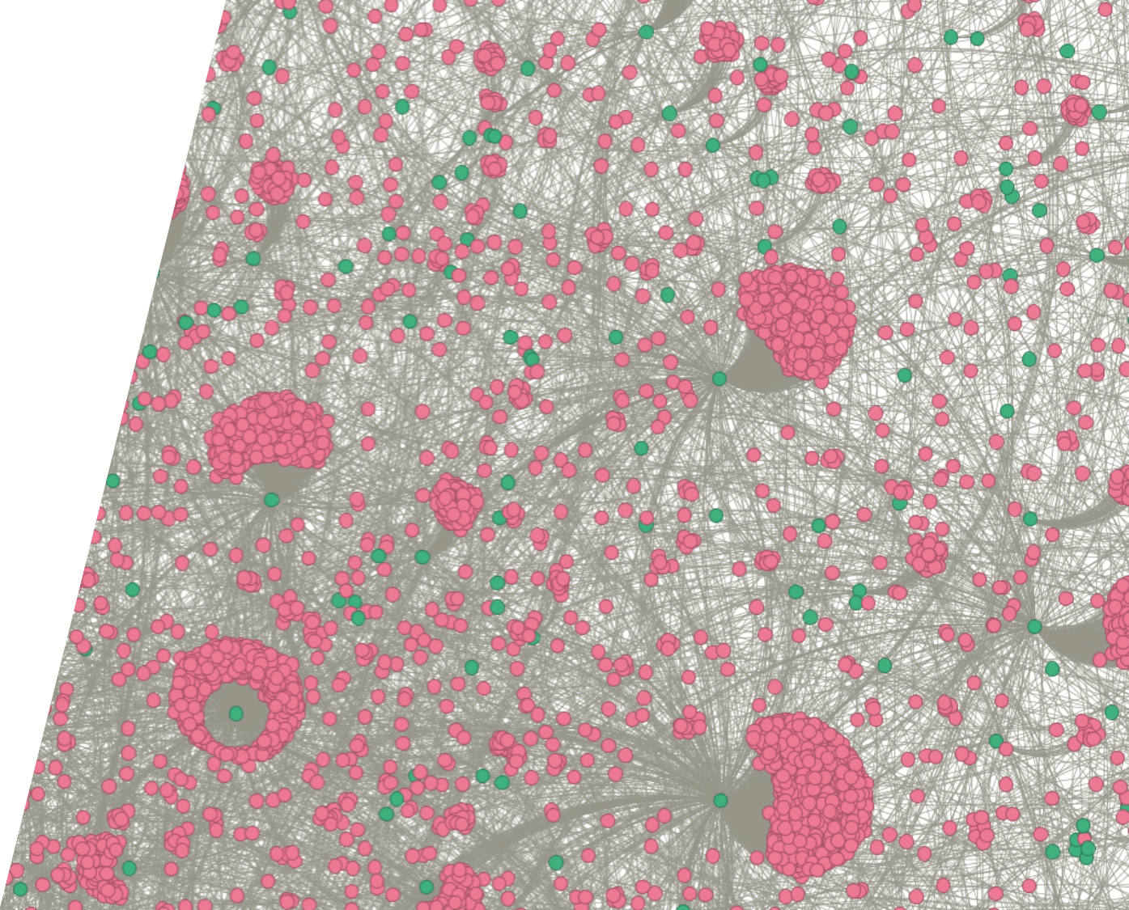
Bipartite Network
Database analyzed was reddit-user to reddit-forum interaction represented as a bipartite network.
Notes:
These interactions form a bipartite network between user and forum.
The green nodes are forums, while the pink are the users.

Slide 6
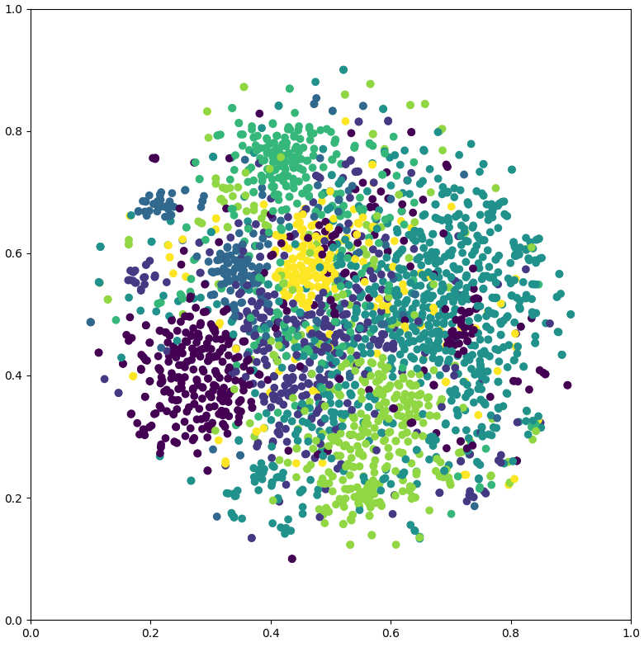
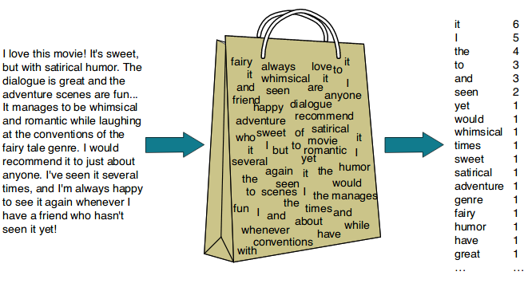
Features
Features for interactions were selected using a bag of words vectorization.
Notes:
Now we talk about the features selected for the learning process.
Features were generated for each user based on a conglomeration of their messages.
Their messages where then vectorized using a bag of words approach where a list of numbers represent the number of times each word was used.
This helps to identify anomalous users who use unusual words or common words as other anomalies.

Slide 7
Anomalous Transaction Detection
On Financial Fraud Semi Supervised Dataset
Notes:
This was the second dataset tested with this method. We picked this method because it has been extensively studied and had an overall low accuracy with the top anomaly detection method called GTAN which had an AUC of 0.7616.

Slide 8
Bipartite Network
Transactions were formed into a bipartite network with the same method of sender – receiver interactions
Notes:
A similar method was proposed for this dataset as hyper edges could be represented as the merchants and the nodes could be the transaction itself.
The main difference here is that the nodes are transactions rather than the sender.

Slide 9
Features
Features were selected using the following metrics:
Sender, Amount, Time, Location, and Transaction Type

Slide 10
Deep hypergraph Model
____
___
___

Slide 11
Results
 | Accuracy | F1 Score
Reddit | _ | _
FFSD | 0.8451 | 0.6374

Slide 12


Thank you
DEVEN BIEHLER
SAI KOLAGANI
deven.biehler@wsu.edu
s.kolagani@wsu.edu

Slide 13
TIMELINE
Deploy strategic networks with compelling e-business needs
SEP 20XX
Synergize scalable e-commerce
NOV 20XX
Disseminate standardized metrics
Coordinate e-business applications
MARCH 20XX
Foster holistically superior methodologies
MAY 20XX
JAN 20XX

Slide 14
PLAN FOR PRODUCT LAUNCH
PLANNING
Synergize scalable e-commerce
MARKETING
Disseminate standardized metrics
DESIGN
Coordinate e-business applications
STRATEGY
Foster holistically superior methodologies
LAUNCH
Deploy strategic networks with compelling e-business needs
1
2
3
4
5

